Slide 2
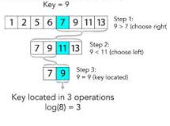
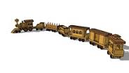
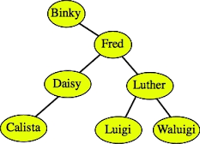
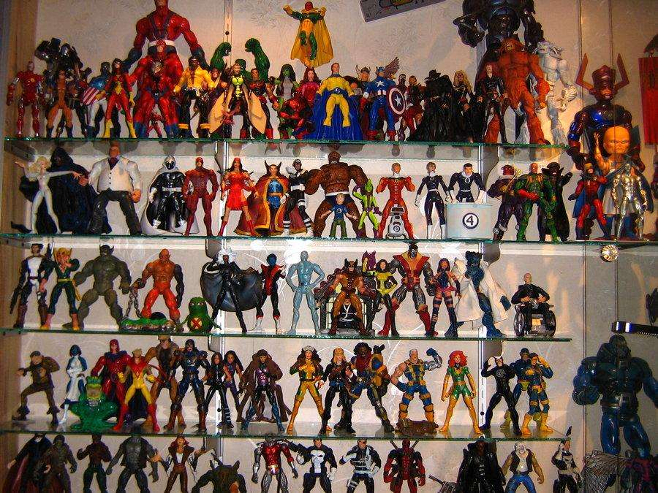



Introduction
Data need to be stored…
Array
Linked List
Sorted array (Binary search)
Binary Search Tree
options???

Slide 3

What is the solution ???

Slide 4

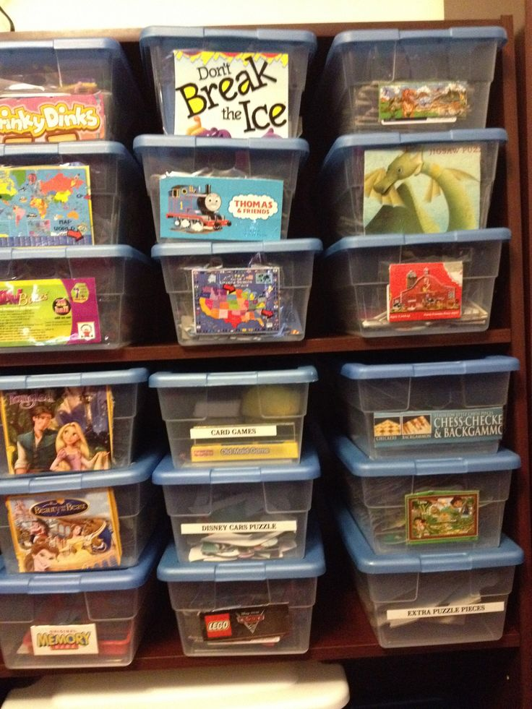
Hash table
a collection of items which are stored in such a way as to make it easy to find them later
Each position of the hash table, often called a slot or a bucket, can hold an item and is named by an integer value starting at 0

Slide 5
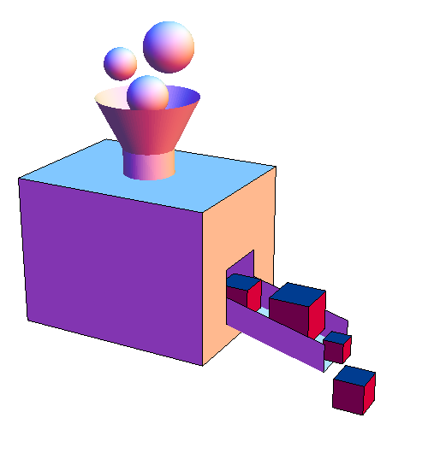
A function that can be used to map a data set of an arbitrary size to a data set of a fixed size, which falls into the hash table.
KEY
INDEX
Hash
Function
The values returned by a hash function are called hash values, hash codes, hash sums, or simply hashes.

Slide 6
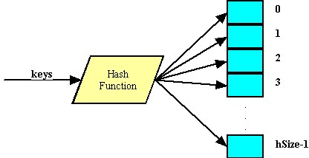
The idea of hashing is to distribute the entries (key/value pairs) across an array of buckets. Given a key, the algorithm computes an index that suggests where the entry can be found:

Slide 7

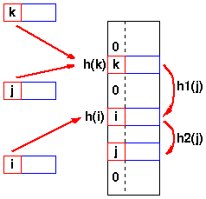
Collision
Two keys may hash to the same table slot.

Slide 8
A “Probe sequence” :
a sequence of slots in hash table while searching for an element x
h0(x) h1(x) h2(x), …
Needs to visit each slot exactly once
Needs to be repeatable (so we can find/delete what we’ve inserted)
Techniques to compute the probe sequences.
Linear probing.
Quadratic probing.
Double hashing.

Slide 9
Linear Probing
This method uses the hash function of the form:
h(k, i) = (h`(k) + i) mod m for i = 0, 1, 2, . . . , m-1
where h` is an auxiliary hash function.

Slide 10
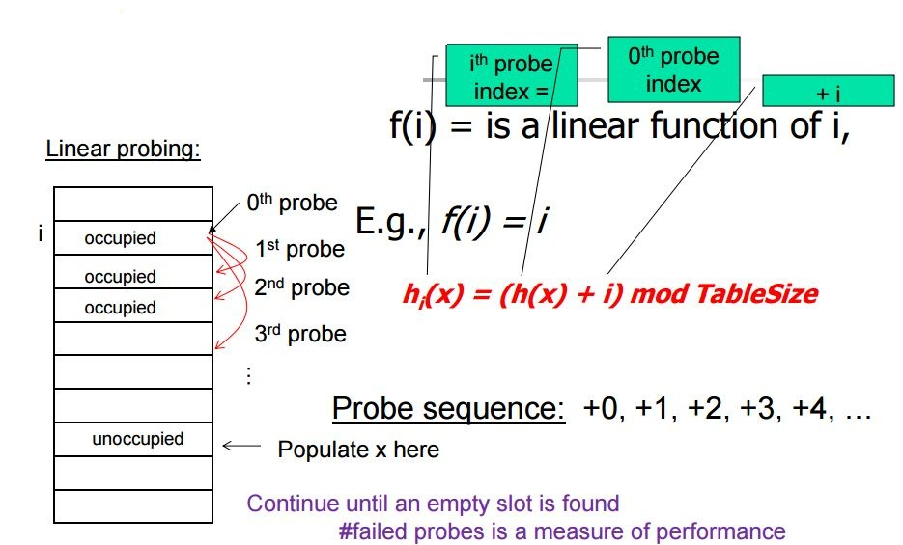
Linear probing suffers primary clustering problem.

Slide 11
2. Quadratic Probing
similar to Linear probing.
difference is:
first check 1^2 = 1 element away
then 2^2 = 4 elements away, then 3^2 =9 and so on.
Consider 1 example:
Table size is 16. First 5 pieces of data that all hash to index 2
First piece goes to index 2.
Second piece goes to 3 ((2 + 1)%16
Third piece goes to 6 ((2+4)%16
Fourth piece goes to 11((2+9)%16
Fifth piece dosen't get inserted because (2+16)%16==2 which is full so we end up back where we started and we haven't searched all empty spots.

Slide 12
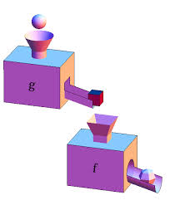
3. Double Hashing
Instead of choosing next opening, a second hash function is used to determine the location of the next spot
Check location hash1(key). If it is empty, put record in it.
If it is not empty calculate hash2(key).
check if hash1(key)+hash2(key) is open, if it is, put it in
repeat with hash1(key)+2hash2(key), hash1(key)+3hash2(key) and so on, until an opening is found.
Notes:
Overflow: there is no space in the bucket for the new pair.
loading density = (number of Keys)/(number of Bucket).

Slide 13




Few other concepts:

Slide 14
Open hashing
Closed hashing
Perfect hashing
Rehashing
Issues in hashing

Slide 15
Hash functions:
Properties of good hashing
Determinism
Uniformity: Each table position equally likely for each key.
Defined range
scramble the keys uniformly.
Efficiently computable.
Practical challenge:
need different approach for each type of key
Ex:
Social Security numbers. • Bad: first three digits. • Better: last three digits.
date of birth. • Bad: birth year. • Better: birthday.
phone numbers. • Bad: first two digits. • Better: last two digits.

Slide 16
Division,
Map a key k into one of m slots by taking the remainder of k divided by m.
That is, the hash function is
h(k) = k mod m.
Example:
If table size m = 12 key k = 100
than h(100) = 100 mod 12 = 4
Poor choices of m: m should not be a power of 2, since if m = 2p, then h(k) is
just the p lowest-order bits of k. So, 2p may be a poor choice, because permuting the characters of k does not
change value. Good m choice of m A prime not too close to an exact of 2.

Slide 17
Multiplication
Two step process
Step 1: Multiply the key k by a constant 0< A < 1 and extract the fraction part of kA. Step 2: Multiply kA by m and take the floor of the result. The hash function using multiplication method is: h(k) = ëm(kA mod 1)û
where "kA mod 1" means the fractional part of kA, that is, kA - ëkAû.
Advantage of this method is that the value of m is not critical and can be implemented on most computers.
A reasonable value of constant A is » (sqrt5 - 1) /2
Extraction
Mid-square

Slide 18
Folding and universal
Open Addressing
This is another way to deal with collisions.
In this technique all elements are stored in the hash table itself. That is, each table entry contains either an element or NIL. When searching for element (or empty slot), we systematically examine slots until we found an element (or empty slot). There are no lists and no elements stored outside the table. That implies that table can completely "fill up"; the load factor α can never exceed 1.Advantage of this technique is that it avoids pointers (pointers need space too). Instead of chasing pointers, we compute the sequence of slots to be examined. To perform insertion, we successively examine or probe, the hash table until we find an empty slot. The sequence of slots probed "depends upon the key being inserted." To determine which slots to probe, the hash function includes the probe number as a second input. Thus, the hash function becomes
h: × {0, 1, . . . m -1 }--> {0, 1, . . . , m-1}
and the probe sequence
< h(k, 0), h(k, 1), . . . , h(k, m-1) >
in which every slot is eventually considered.

Slide 19
Collision resolution strategies:
Open addressing
Chaining
Hash table overflow:
Open addressing
Chaining
Extendible hashing

